Slide 1
Overcoming the C-Suite’s Distrust of AI
Data-based decisions by AI are almost always based on probabilities (probabilistic versus deterministic).
Because of this, there is always a degree of uncertainty when AI delivers a decision.
There has to be an associated degree of confidence or scoring on the reliability of the results.
It is for this reason most systems cannot, will not, and should not be automated.
Humans need to be in the decision loop for the near future
Source: HBR, March 23, 2022

Slide 2
You’re Still Being Tracked on the Internet, Just in a Different Way
Gathering people’s online data for targeted advertising is not going away. That has implications for how companies make money online and how the internet operates. It also underlines the advantages built up by some of the largest digital platforms. is giving some platforms a bigger advertising advantage.
For years, digital businesses relied on what is known as “third party” tracking. Companies such as Facebook and Google deployed technology to trail people everywhere they went online. If someone scrolled through Instagram and then browsed an online shoe store, marketers could use that information to target footwear ads to that person and reap a sale.
Now tracking has shifted to what is known as “first party” tracking. With this method, people are not being trailed from app to app or site to site. But companies are still gathering information on what people are doing on their specific site or app, with users’ consent. This kind of tracking, which companies have practiced for years, is growing.
Source: New York Times Tech Section April 6, 2022

Slide 3
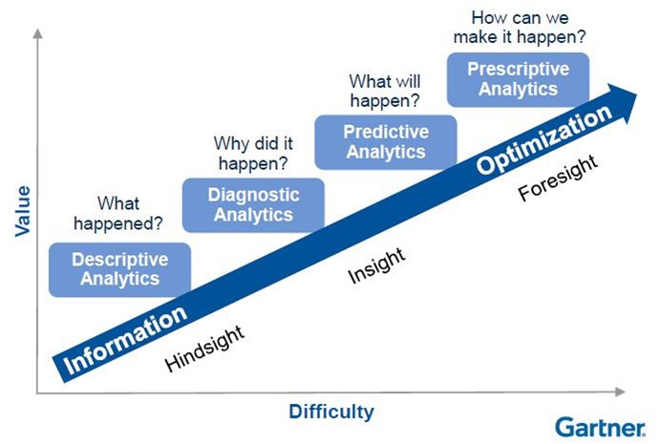
Gartner: Four Types of Analytics Capabilities

Slide 4
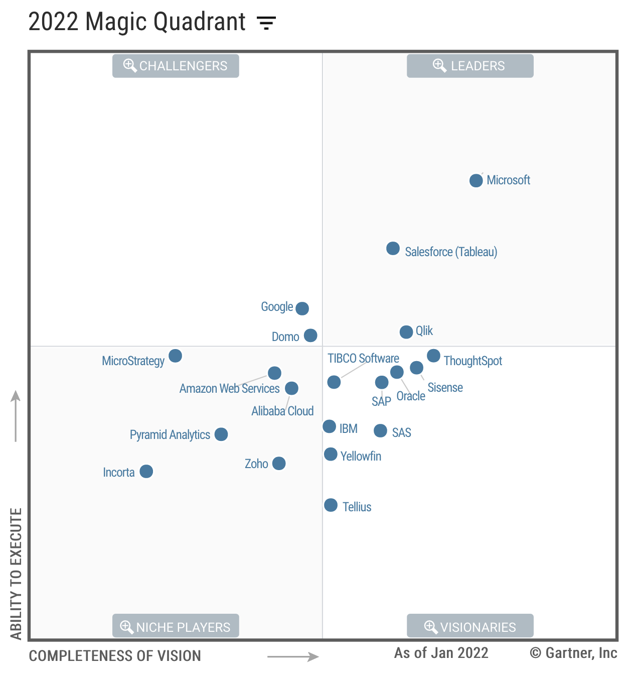
Gartner Magic Quadrant for Analytics and Business Intelligence Platforms

Slide 5
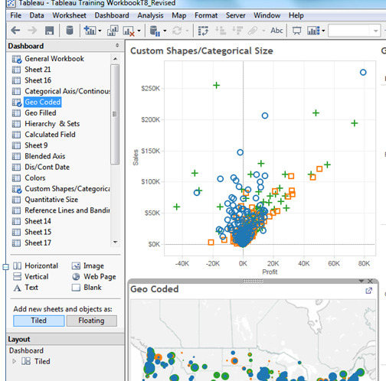
Creating a dashboard
Drag & Drop

Slide 6
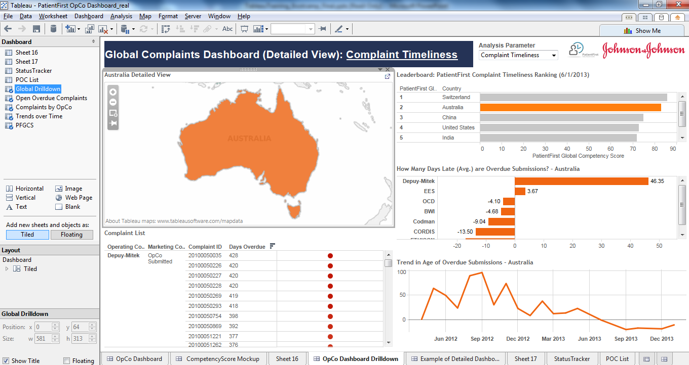
Build a dashboard
Drag/Drop Worksheets
Text
Filter
Image
Vertical Container

Slide 7
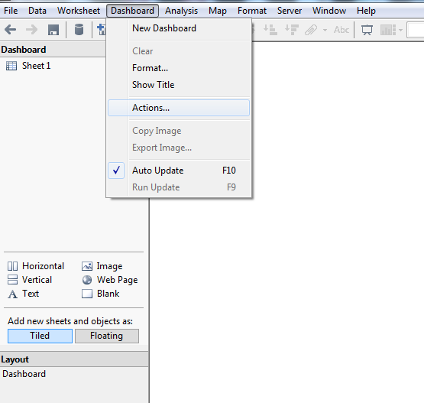
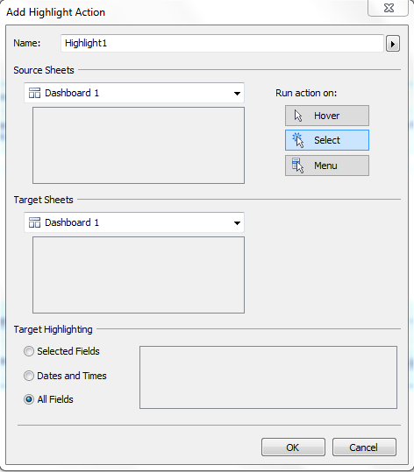
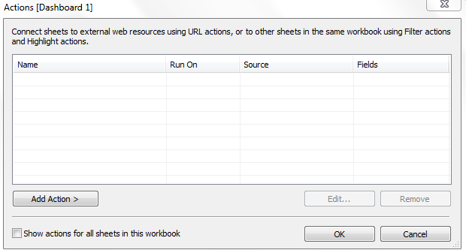
Useful features
Action filters and highlighting
Select Worksheet > Actions
Add Action > Highlight/Filters
Give name
Select source sheet
Select how you want to launch action
Select target sheet
Select fields you want to highlight

Slide 8




Data visualization best practices
Avoid rookie mistakes by leveraging a few data visualization best practices
Clean data is good data when it comes to data analytics, properly formatted and structured data is essential
Simple visualizations are the easiest to comprehend, so keep unnecessary graphics, colors, and shapes to a minimum
Garbage In, Garbage Out
Increase the Data-to-Ink Ratio
Pie is great to eat but bad for visualizing data as it makes it difficult to distinguish relativity. Use bar charts instead
It’s easy to default to using a map view when you have geographic data, but they are really only needed when showing trends by location
No Pie Charts!
Do You Really Need a Map?

Slide 9
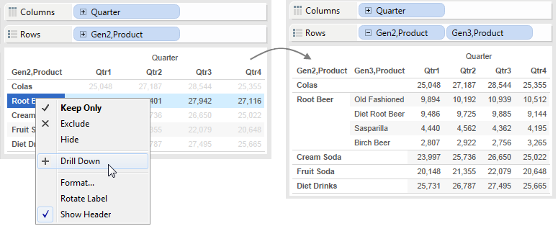
Drilling down

